Slide 1
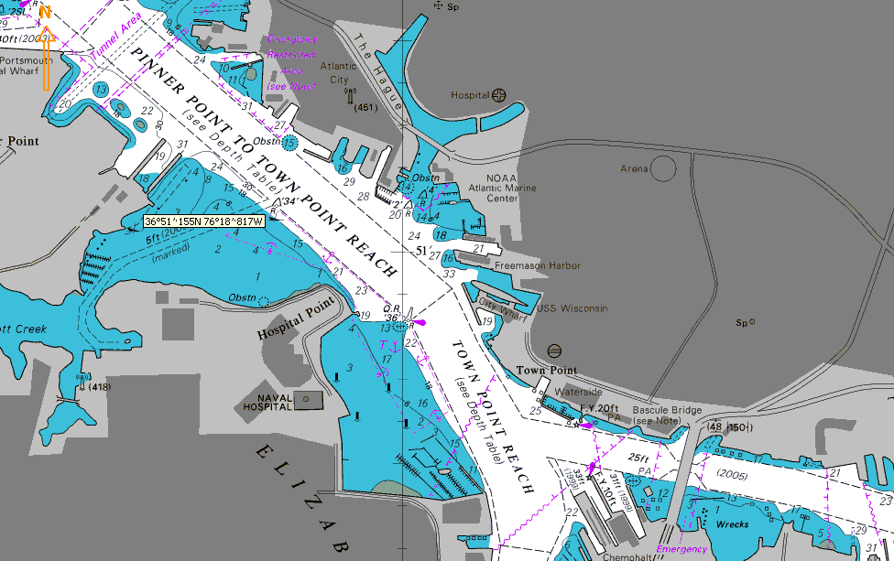
NOAA Atlantic Marine Centre
Nauticus
Marriott
Extract from BA 2814
Norfolk Harbor and Elizabeth River

Slide 2
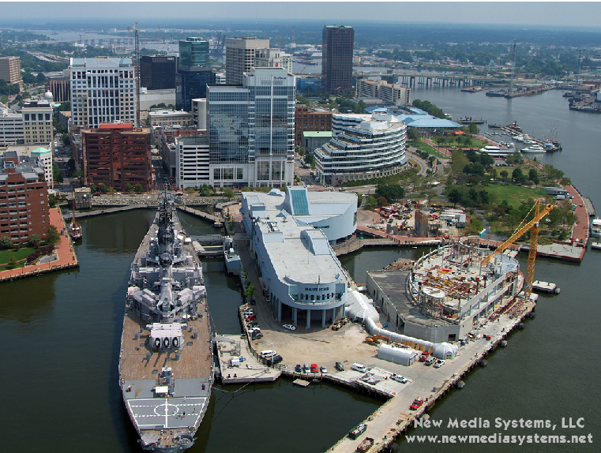
Marriott
USS Wisconsin
Nauticus

